Slide 1
2. SOME CONSTITUTIONAL REMARKS

Slide 2
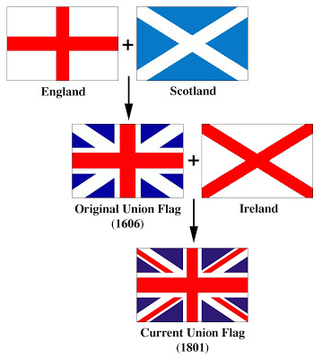
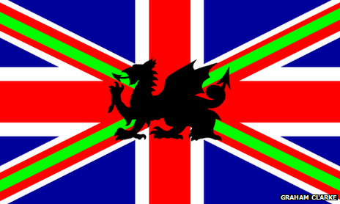
National flag of the UK:
England = St George's cross
Scotland = St Andrew's Cross
Ireland (!) = St Patrick's Cross
Union Flag, sometimes called the Union Jack, = unity of the three countries.
Welsh national flag = ?
Complex links

Slide 3
The U.K.
member of the United Nations & former member of the EU (since Jan 1st, 2021)
one single and unitary state (land with a sovereign government)
constitutional monarchy
Queen = symbol of this state.

Slide 4
3. POPULATION AND LINGUISTICS

Slide 5
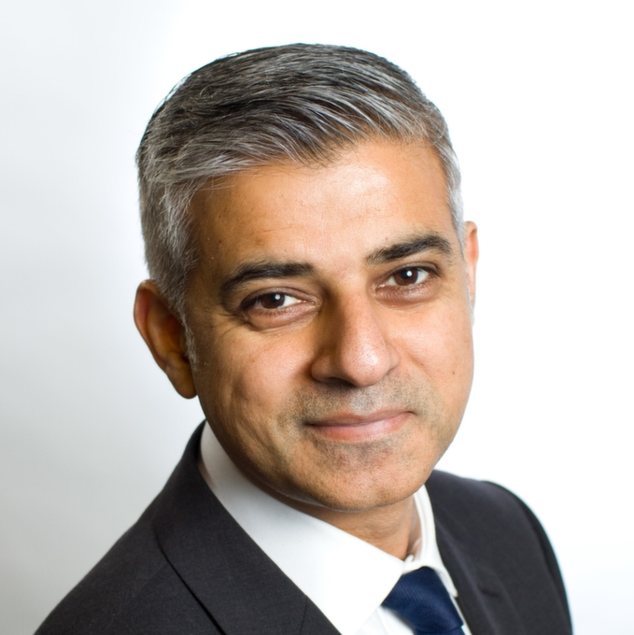
A) Population
British identity?
No longer only WASP (White Anglo Saxon Protestant)
Great diversity of culture thanks to various
Migration processes and waves
Sadiq Khan

Slide 6
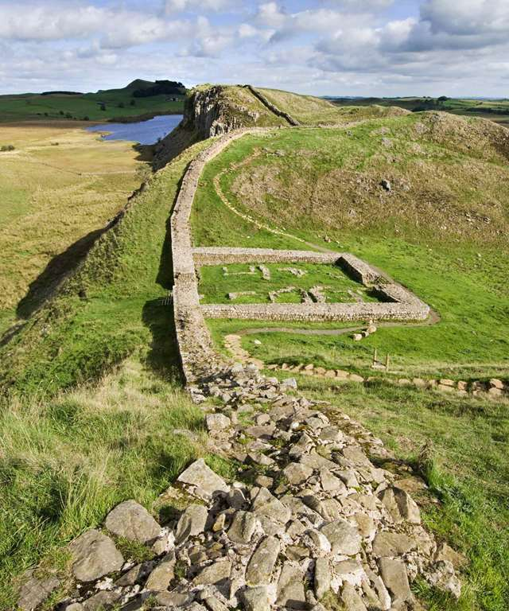
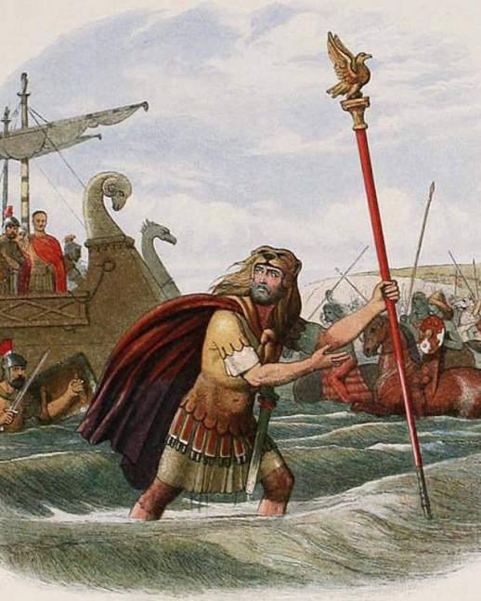
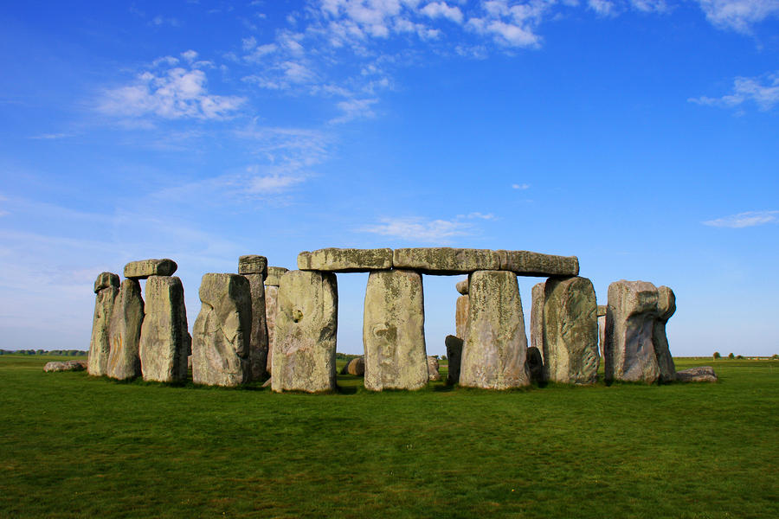
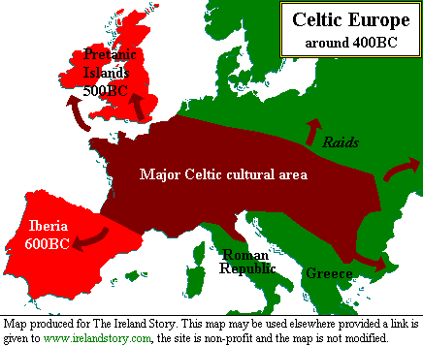
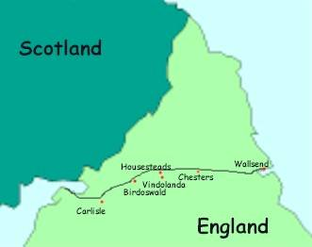
500 BC :Migration from the Celts (warrior peoples ex. Picts and Scotti)
Roman invasion (300 AD)
Pushed the Celts in Ireland, Wales and Scotland
Local resistance (Picts)
Vestiges = Hadrian’s Wall
Notes:
NB: AD = Anno Domini (vs. BC = Before Christ)

Slide 7
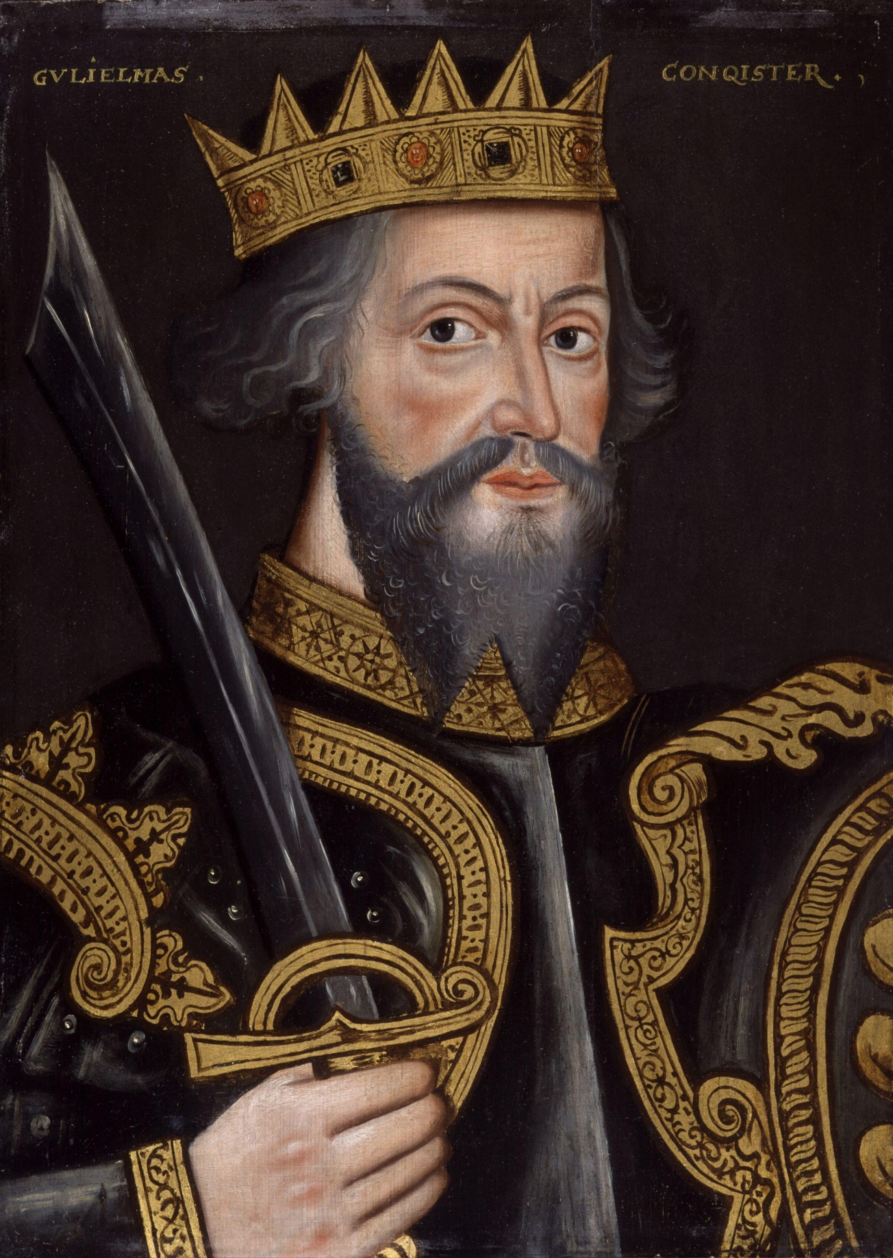
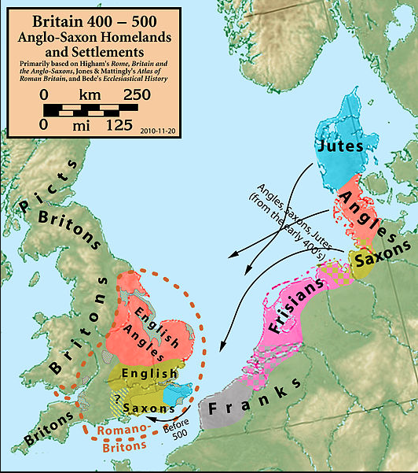
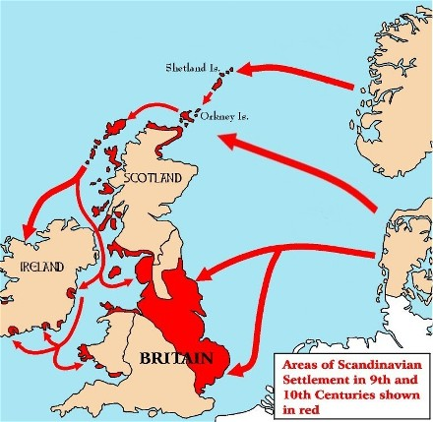
5th century: final Roman withdrawal
Invasion by Angles, Saxons and Jutes (Germanic tribe) from Northern Europe.
Raids and settlements by Vikings from Scandinavia.
1066: Duke William of Normandy defeated the English at the battle of Hastings.

Slide 8
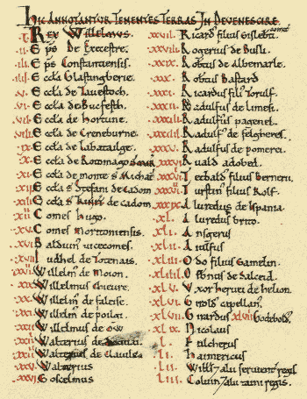
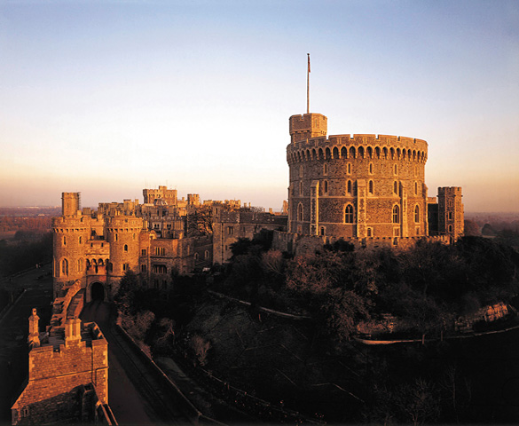
Consequences of the invasion
Physical landscape
Domesday Book (first census)
French language

Slide 9
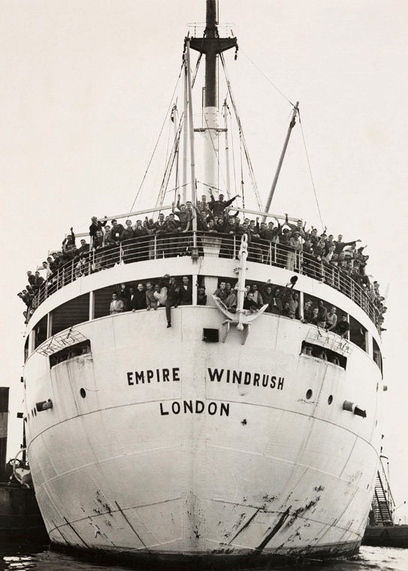
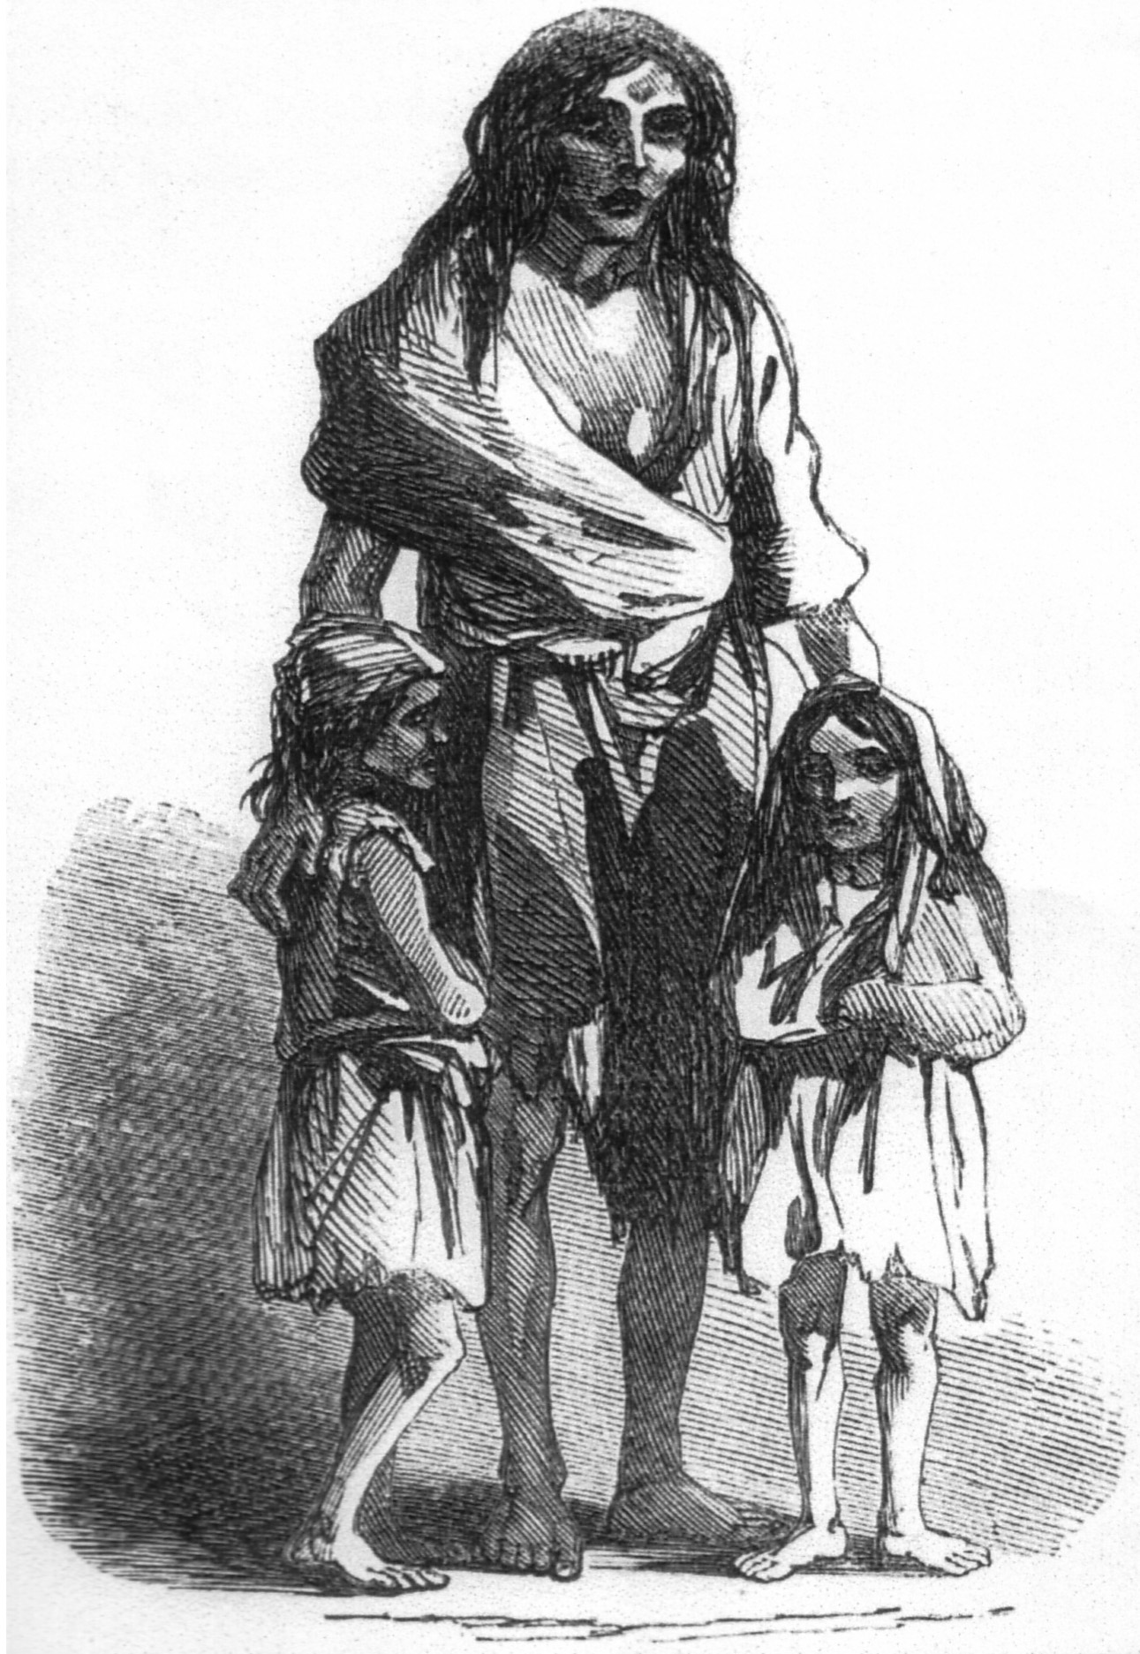
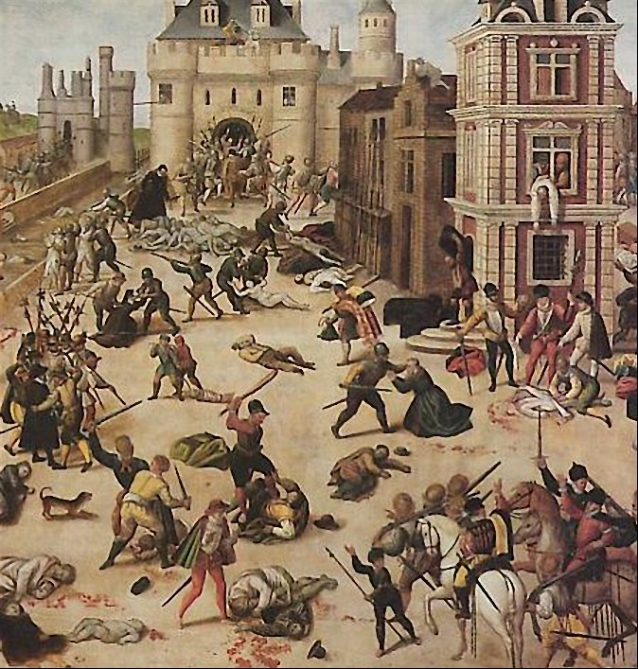
Last four centuries: religious persecution, economic hardship, or political considerations => other immigration waves
Protestants/Jews
Irish people (poverty, famines)
20th century, immigration from the old Empire and the Commonwealth
1948: arrival of the Empire Windrush
British multiculturalism (sadly not deprived of tensions/ xenophobia and racism. Cf pro-Brexit campaigns for instance)

Slide 10
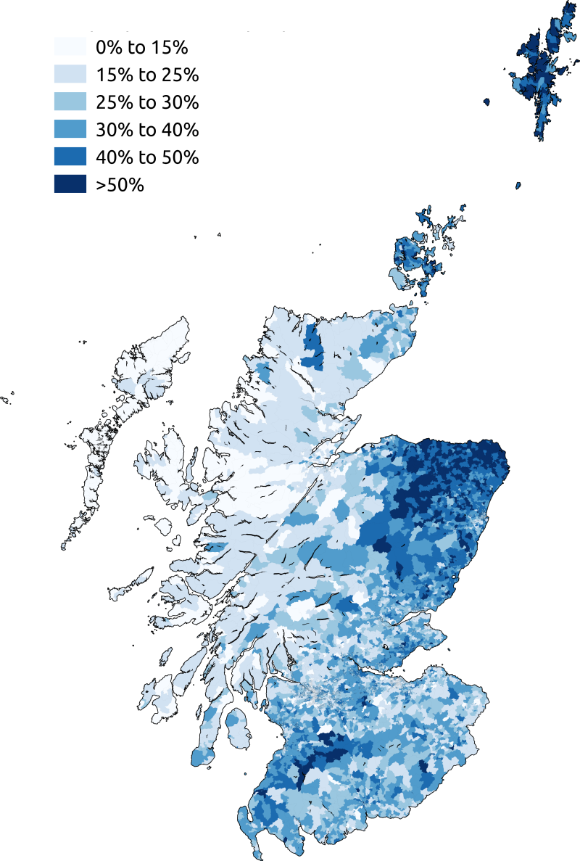
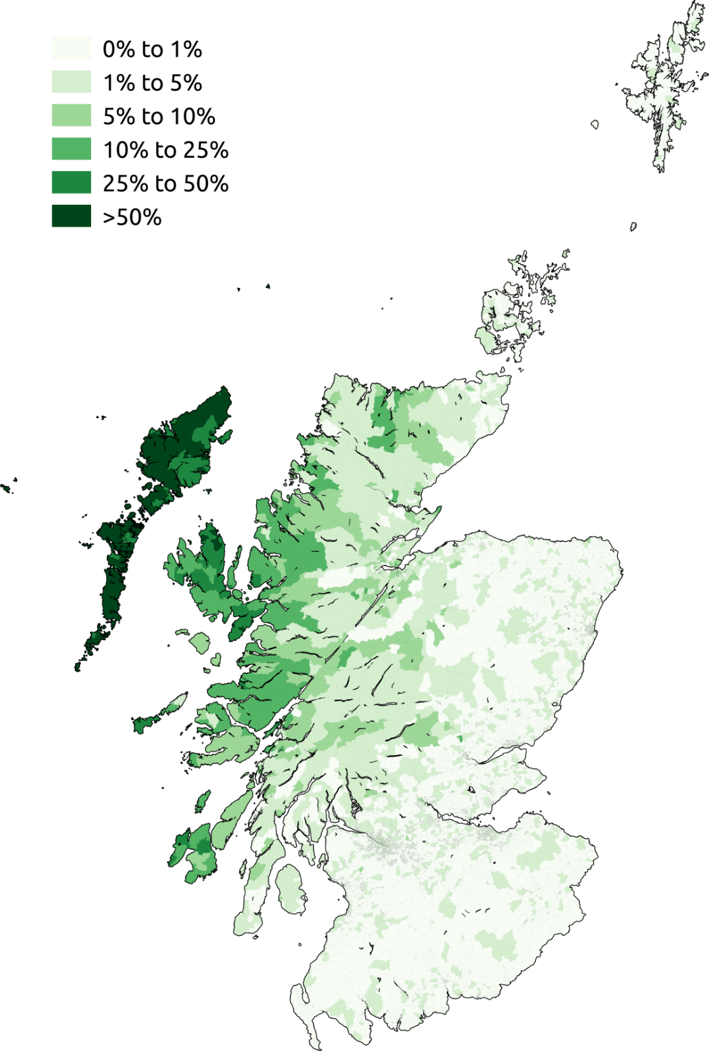
B) Language
Official language of the U.K. = English
Some other languages
Celtic groups.
Scotland = Scots (South & Midlands)+ Gaelic (Highlands and islands)
As of 2020, about 1 million Scots speakers (over 5.46 million people)
57,000 fluent L1 and L2 Scottish Gaelic speakers (2011)
Neither is an official language

Slide 11
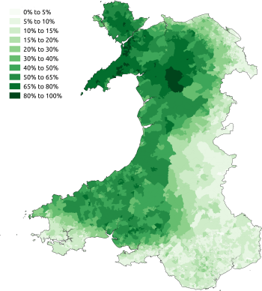
B) Languages
Wales = Welsh language (//Breton)
From 30% in 1890 to 2% in 1950
2020: ~29% Welsh people said were able to speak Welsh + ~16% speak Welsh daily.
1967 Welsh Language Act: gave some rights to use Welsh in legal proceedings. Cf Sianel Pedwar Cymru (S4C) TV station.
The Welsh Language Measure (2011): Welsh language given official status in Wales (both the Welsh language and English official languages of the Senedd Cymru/Welsh Parliament)
The Welsh government plans to have 1 million Welsh language speakers by 2050.

Slide 12
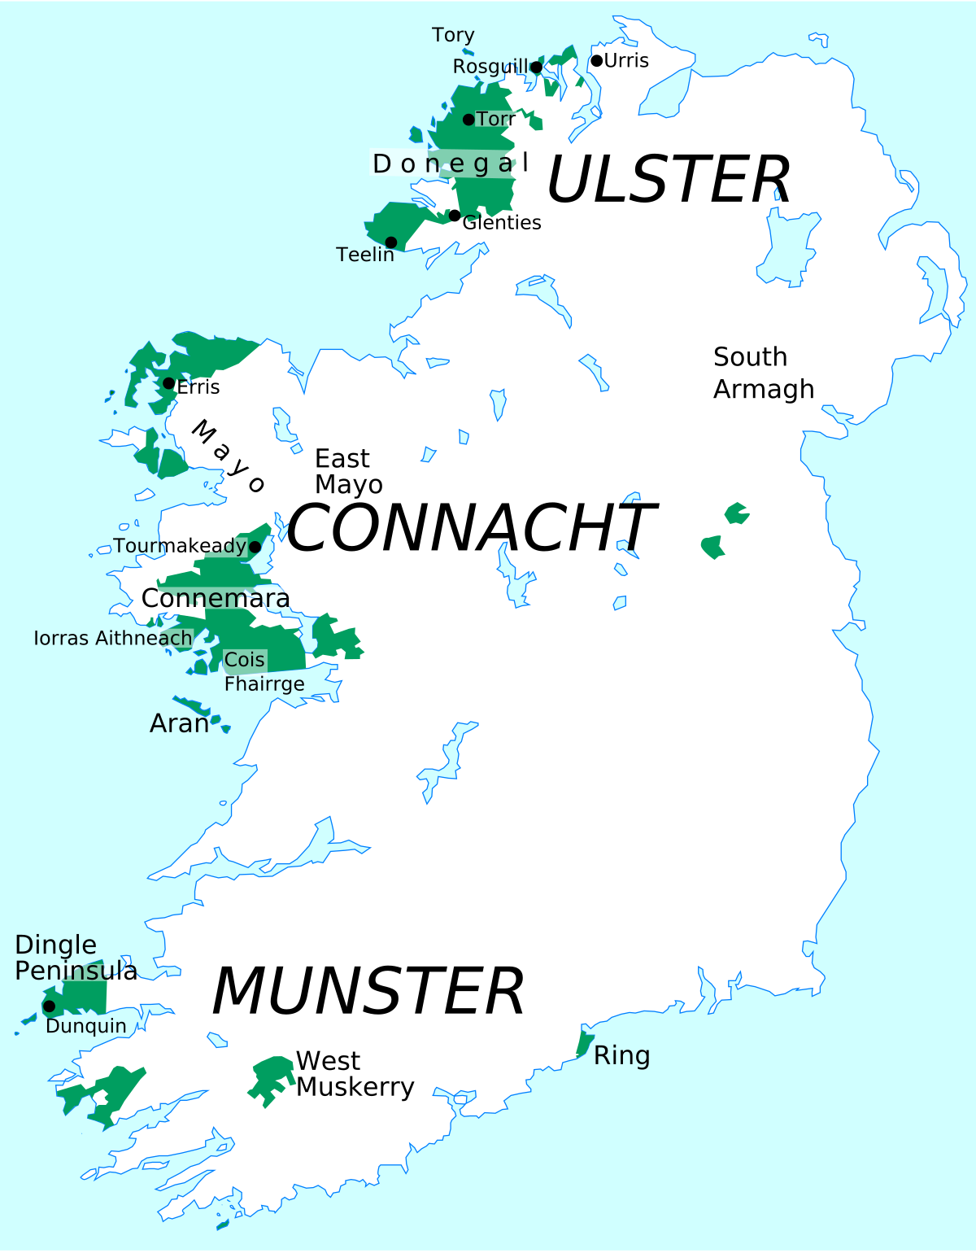
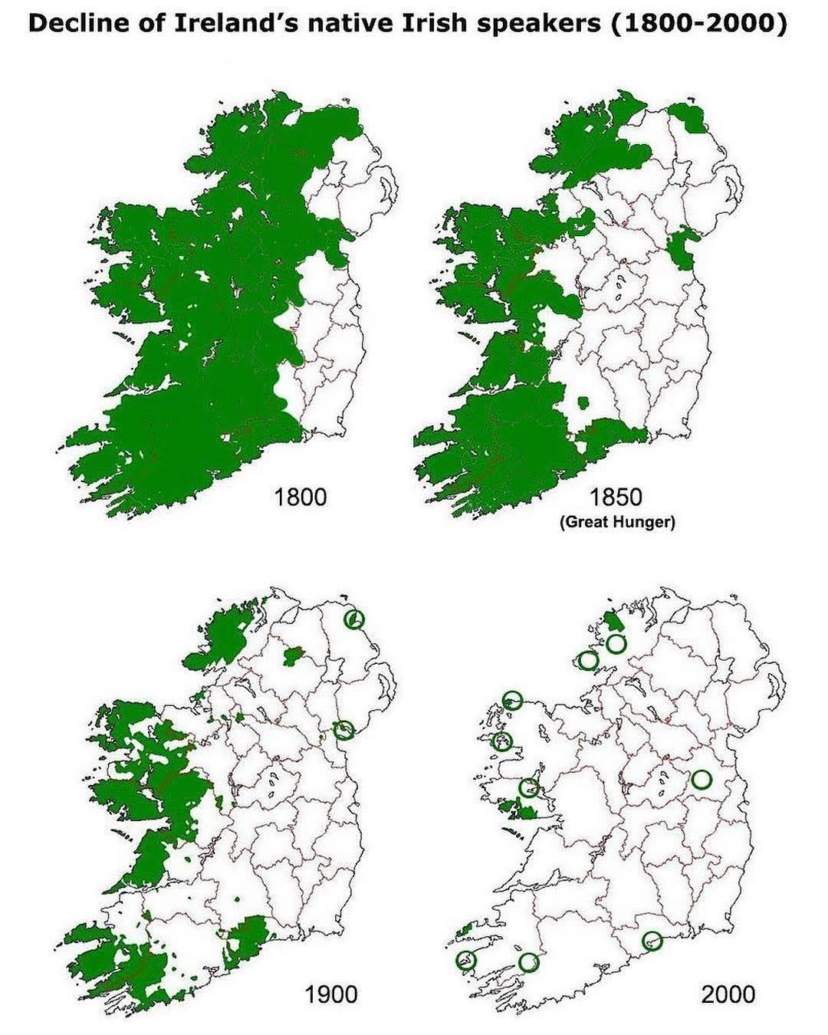
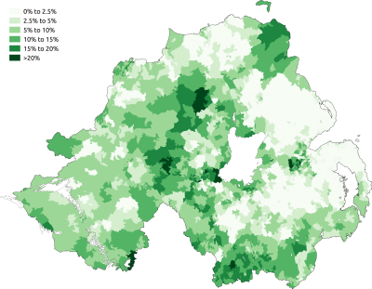
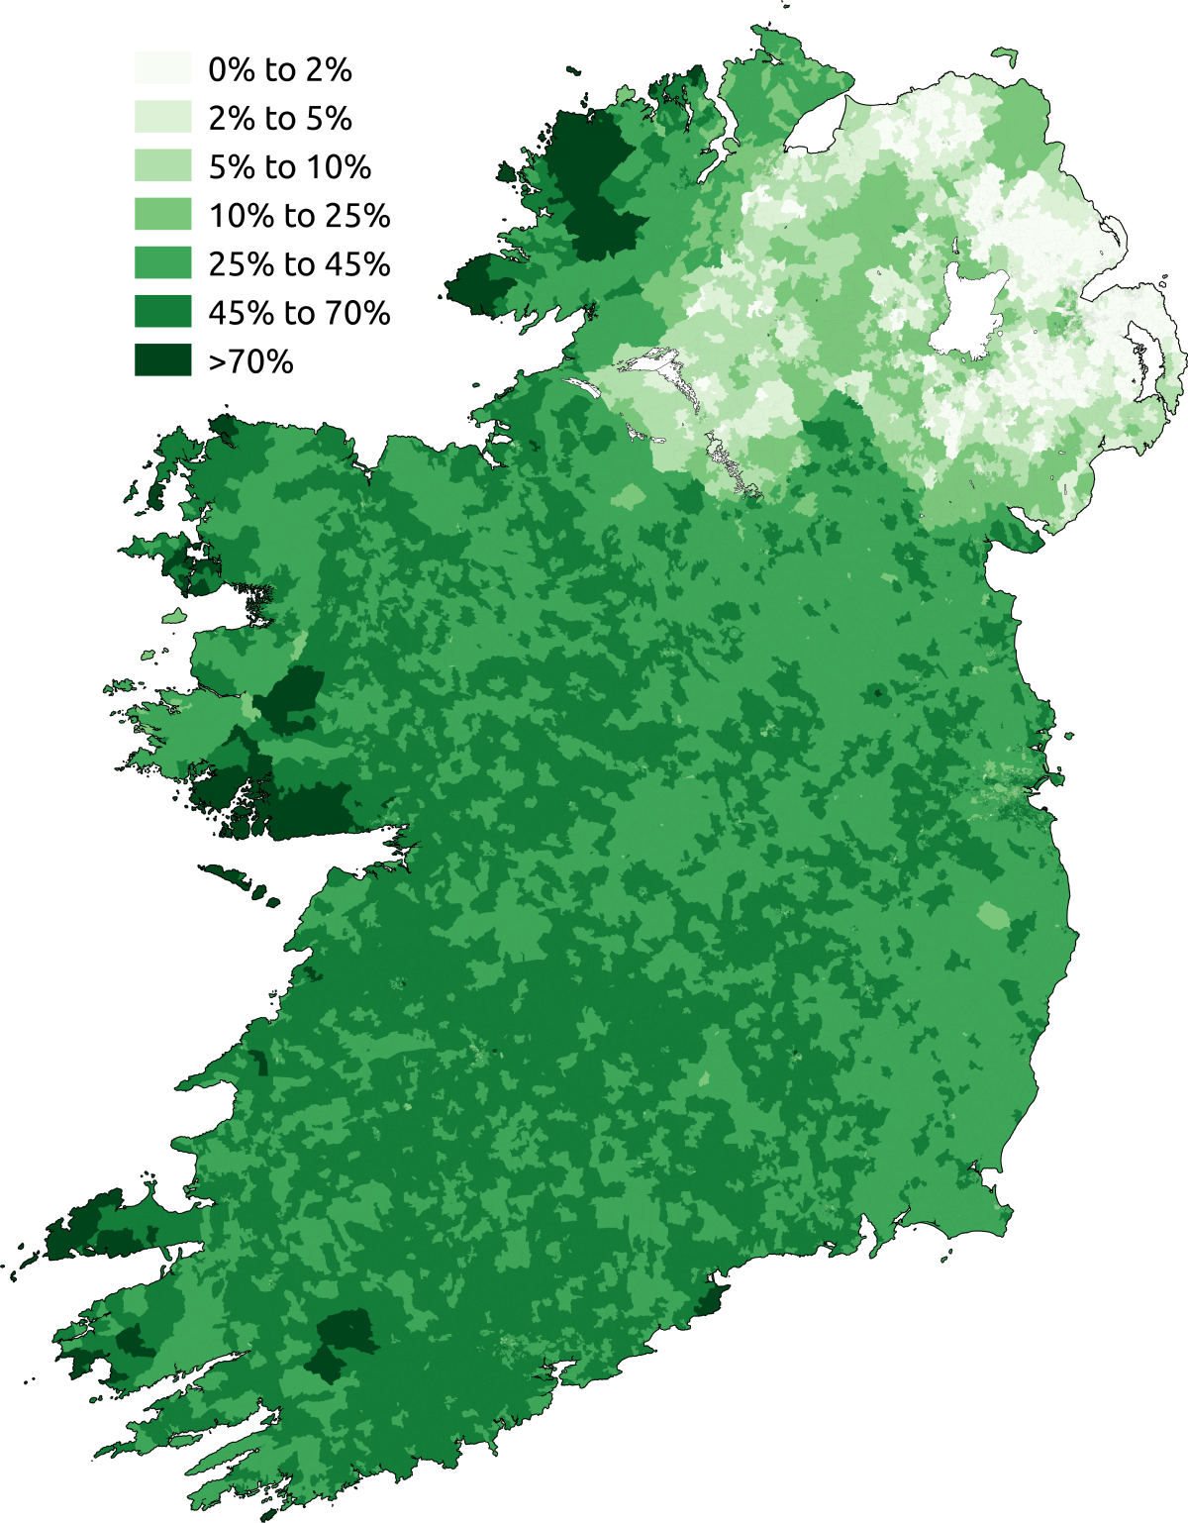
Ireland: Irish Gaelic
Prior to colonisation: first language; now mostly second language.
Gaeltacht (plu: Gaeltachtaí)
First and official language of the Republic of Ireland.
2019: 170,000~ Irish people using Irish as a first language (daily usage: ~70,000) + about 1.6 million citizens able to use it as a second language.
Political will to revitalise Irish Gaelic (taught in school)
Minority language in Northern Ireland. Highly political issue (in 2006 the British government promised to enact legislation to promote the language but has yet to do so)

